Slide 1

Memory in computer is any physical device that can store data or programs temporarily or permanently for use in an electronic digital computer

Slide 2

Why do we need a computer memory?
In the computer system, we need computer memory to store various types of data like text, images, video, audio, documents, etc. We can retrieve it when the data is required. For example, when we write and execute any computer program, it is initially stored in primary memory. If the processor does not need particular items for a longer time, the program or data is automatically saved into the permanent or secondary memory. Then the data is called from secondary memory to main memory and performs the execution of codes.

Slide 3

Features of Memory
Location: It represents the internal or external location of the memory in a computer. The internal memory is inbuilt in computer memory. It is also known as primary memory. the example of primary memory are registers, cache and main memory. Whereas, external memory is the separate storage device from the computer, such as disk, tape, USB pen drive.
Capacity: It is the most important feature of computer memory. Storage capacity can vary in external and internal memory. External devices' storage capacity is measured in terms of bytes, whereas the internal memory is measured with bytes or words. The storage word length can vary in bits, such as 8, 16 or 32 bits.

Slide 4
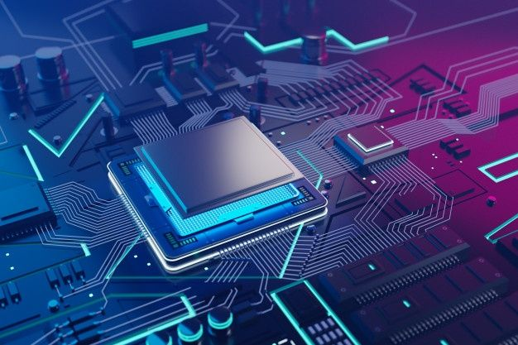
Access Methods: Memory can be accessed through four modes of memory.
DMA: As the name specifies, Direct Memory Address (DMA) is a method that allows input/output (I/O) devices to access or retrieve data directly or from the main memory.
Sequential Access Method: The sequential access method is used in a data storage device to read stored data sequentially from the computer memory. Whereas, the data received from random access memory (RAM) can be in any order.
Random Access Method: It is a method used to randomly access data from memory. This method is the opposite of SAM. For example, to go from A to Z in random access, we can directly jump to any specified location. In the Sequential method, we have to follow all intervening from A to Z to reach at the particular memory location.
Associative Access Method: It is a special type of memory that optimizes search performance through defined data to directly access the stored information based on a memory address.

Slide 5
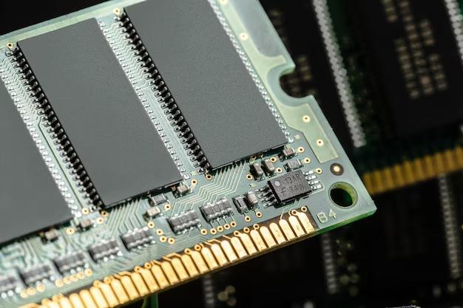
Unit of transfer: As the name suggests, a unit of transfer measures the transfer rate of bits that can be read or write in or out of the memory devices. The transfer rate of data can be different in external and internal memory.
Internal memory: The transfer rate of bits is mostly equal to the word size.
External memory: The transfer rate of bit or unit is not equal to the word length. It is always greater than a word or may be referred to as blocks.

Slide 6

Performance: The performance of memory is majorly divided into three parts.
Access Time: In random access memory, it represents the total time taken by memory devices to perform a read or write operation that an address is sent to memory.
Memory Cycle Time: Total time required to access memory block and additional required time before starting second access.
Transfer rate: It describes the transfer rate of data used to transmit memory to or from an external or internal memory device. Bit transfer can be different for different external and internal devices.

Slide 7
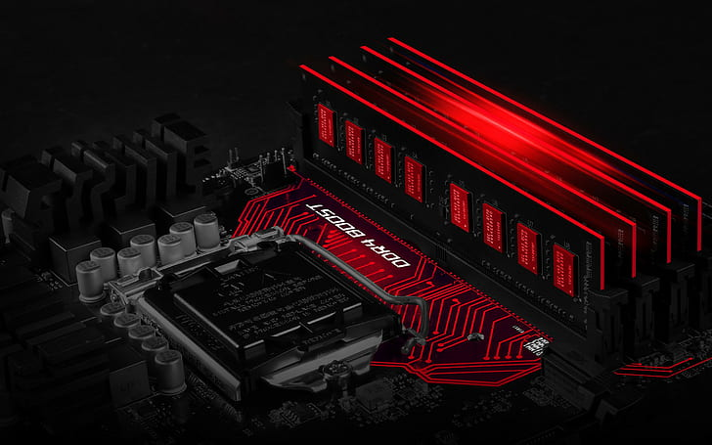
Physical types: It defines the physical type of memory used in a computer such as magnetic, semiconductor, magneto-optical and optical.
Organization: It defines the physical structure of the bits used in memory.
Physical characteristics: It specifies the physical behavior of the memory like volatile, non-volatile or non-erasable memory. Volatile memory is known as RAM, which requires power to retain stored information, and if any power loss has occurred, stored data will be lost. Non-volatile memory is a permanent storage memory that is used to obtain any stored information, even when the power is off. Non-erasable memory is a type of memory that cannot be erased after the manufactured like ROM because at the time of manufactured ROM are programmed.

Slide 8
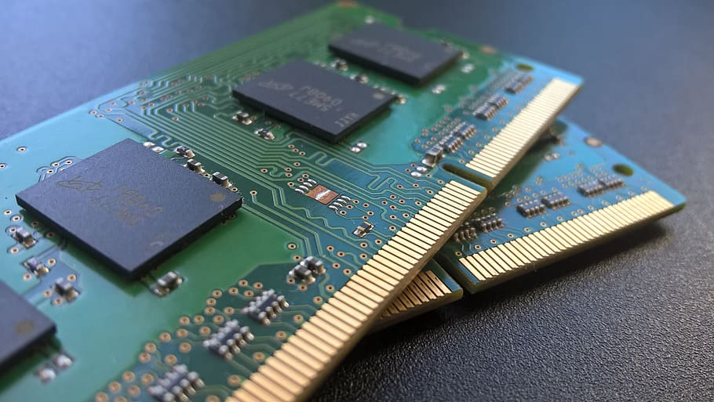
Primary or Main Memory
Primary memory is also known as the computer system's main memory that communicates directly within the CPU, Auxiliary memory and the Cache memory. Main memory is used to kept programs or data when the processor is active to use them. When a program or data is activated to execute, the processor first loads instructions or programs from secondary memory into main memory, and then the processor starts execution. Accessing or executing of data from primary memory is faster because it has a cache or register memory that provides faster response, and it is located closer to the CPU. The primary memory is volatile, which means the data in memory can be lost if it is not saved when a power failure occurs. It is costlier than secondary memory, and the main memory capacity is limited as compared to secondary memory.
The primary memory is further divided into two parts:
RAM (Random Access Memory)
ROM (Read Only Memory)

Slide 9
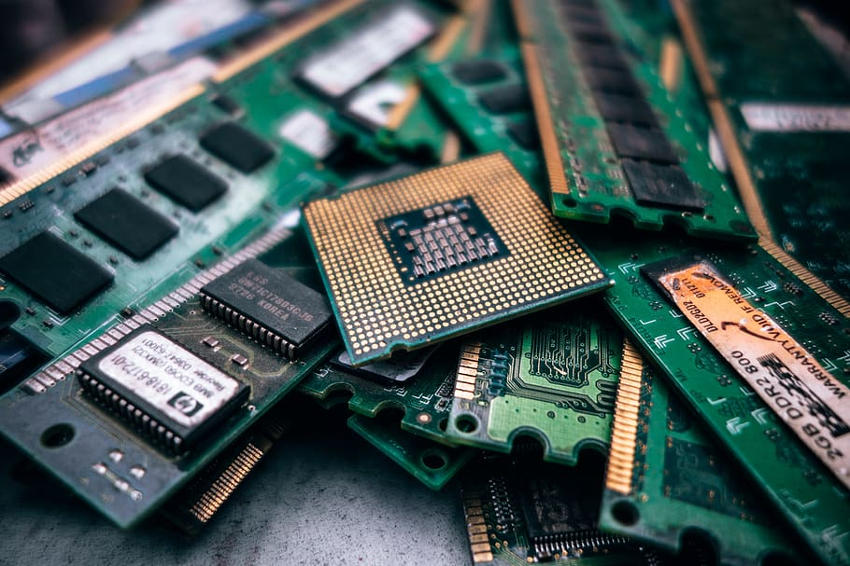
Random Access Memory (RAM)
Random Access Memory (RAM) is one of the faster types of main memory accessed directly by the CPU. It is the hardware in a computer device to temporarily store data, programs or program results. It is used to read/write data in memory until the machine is working. It is volatile, which means if a power failure occurs or the computer is turned off, the information stored in RAM will be lost. All data stored in computer memory can be read or accessed randomly at any time.
There are two types of RAM:
SRAM
DRAM

Slide 10

Read-Only Memory (ROM)
ROM is a memory device or storage medium that is used to permanently store information inside a chip. It is a read-only memory that can only read stored information, data or programs, but we cannot write or modify anything. A ROM contains some important instructions or program data that are required to start or boot a computer. It is a non-volatile memory; it means that the stored information cannot be lost even when the power is turned off or the system is shut down.
Type of ROM:
PROM (Programmable Read Only Memory)
EPROM (Erasable and Programmable Read Only Memory)
EEPROM (Electrically Erasable and Programmable Read Only Memory)

